Slide 1
Query Processing & Optimization

Slide 2
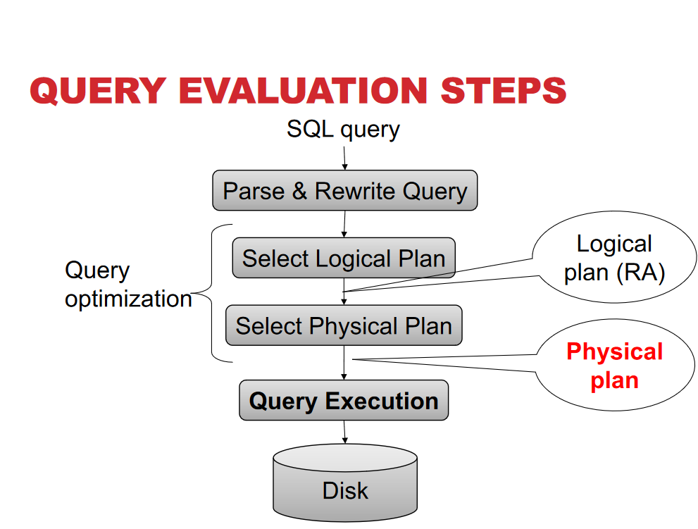

Slide 3
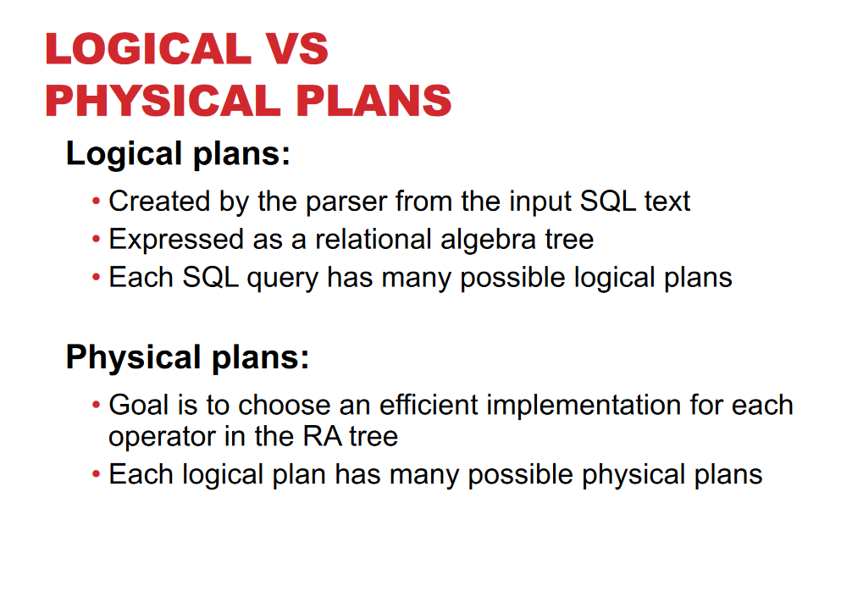

Slide 4
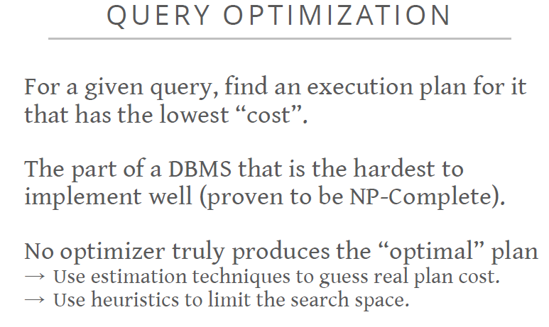

Slide 5
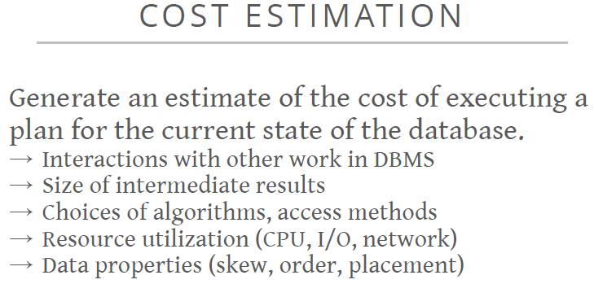

Slide 6
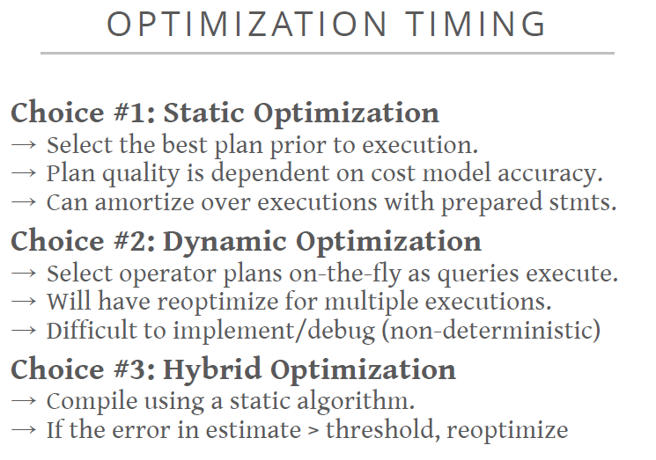

Slide 7
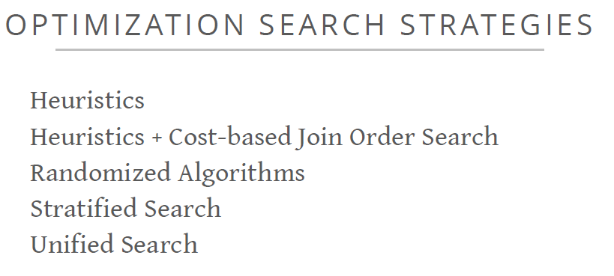

Slide 8
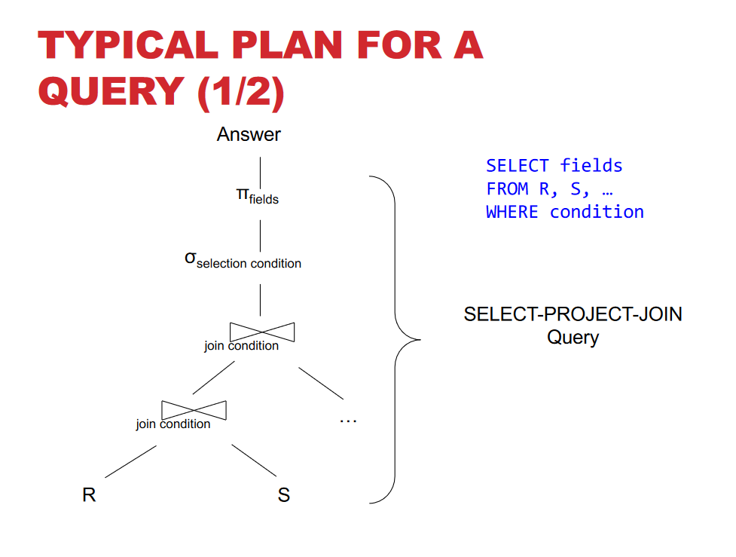

Slide 9
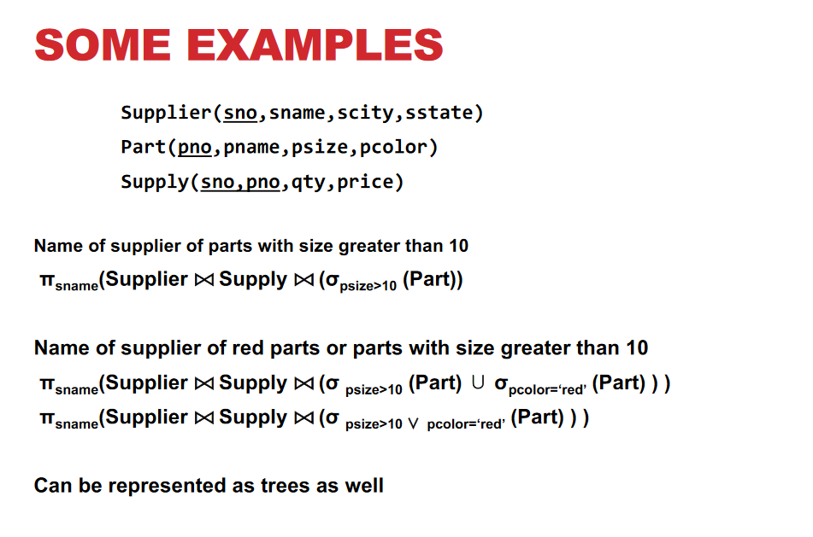

Slide 10
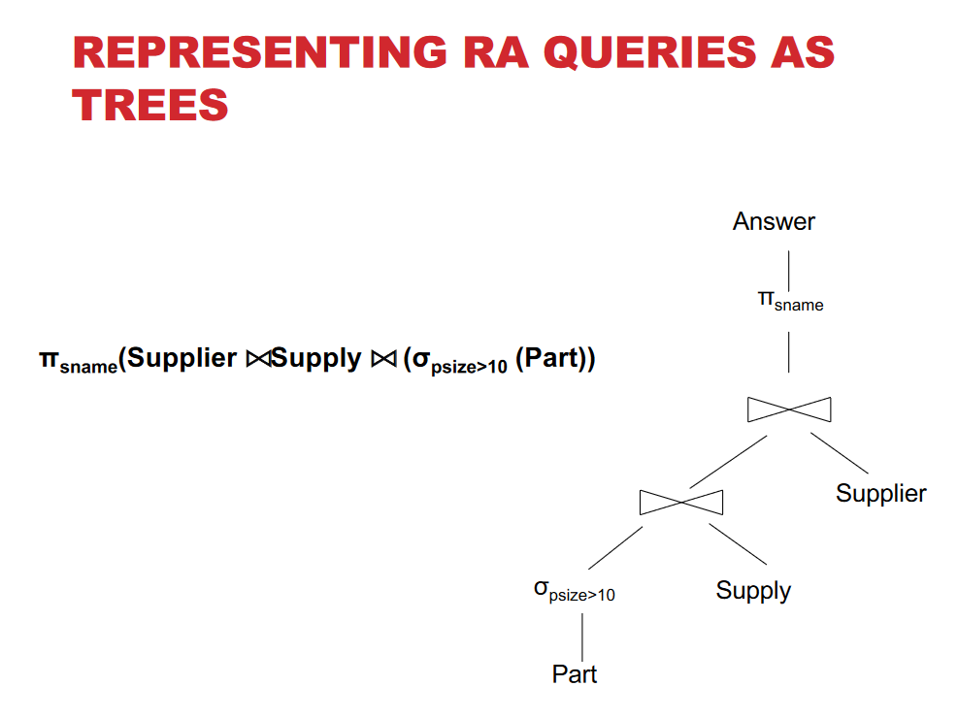

Slide 11
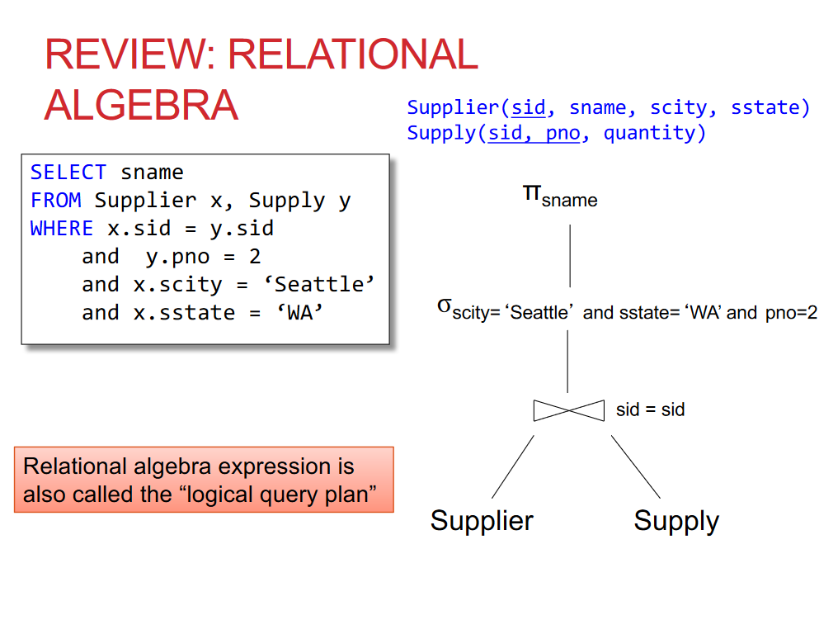

Slide 12
Nested loop (loop over loop)
In this algorithm, an outer loop is formed which consists of few entries and then for each entry, and inner loop is processed.
Ex:
Select tab1.*, tab2.* from tab1, tab2 where tab1.col1=tab2.col2;
It is processed like:
For i in (select * from tab1) loop For j in (select * from tab2 where col2=i.col1) loop Display results; End loop; End loop;
The Steps involved in doing nested loop are:
a) Identify outer (driving) table
b) Assign inner (driven) table to outer table.
c) For every row of outer table, access the rows of inner table.
Optimizer may not use nested loop in case:
No of rows of both the table is quite high
Inner query always results in same set of records
The access path of inner table is independent of data coming from outer table.

Slide 13
Hash join
Hash joins are used when the joining large tables. The optimizer uses smaller of the 2 tables to build a hash table in memory and the scans the large tables and compares the hash value (of rows from large table) with this hash table to find the joined rows.
The algorithm of hash join is divided in two parts
Build a in-memory hash table on smaller of the two tables.
Probe this hash table with hash value for each row second table
In simpler terms it works like
Build phase
For each row RW1 in small (left/build) table loop Calculate hash value on RW1 join key Insert RW1 in appropriate hash bucket. End loop;
Probe Phase
For each row RW2 in big (right/probe) table loop Calculate the hash value on RW2 join key For each row RW1 in hash table loop If RW1 joins with RW2 Return RW1, RW2 End loop; End loop;

Slide 14
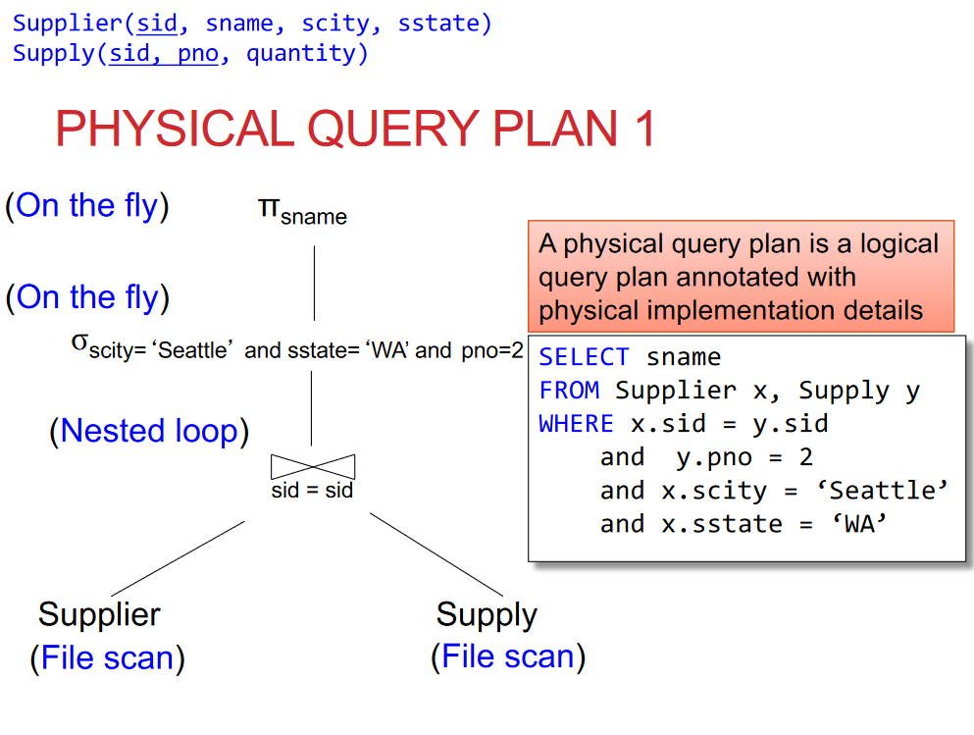

Slide 15
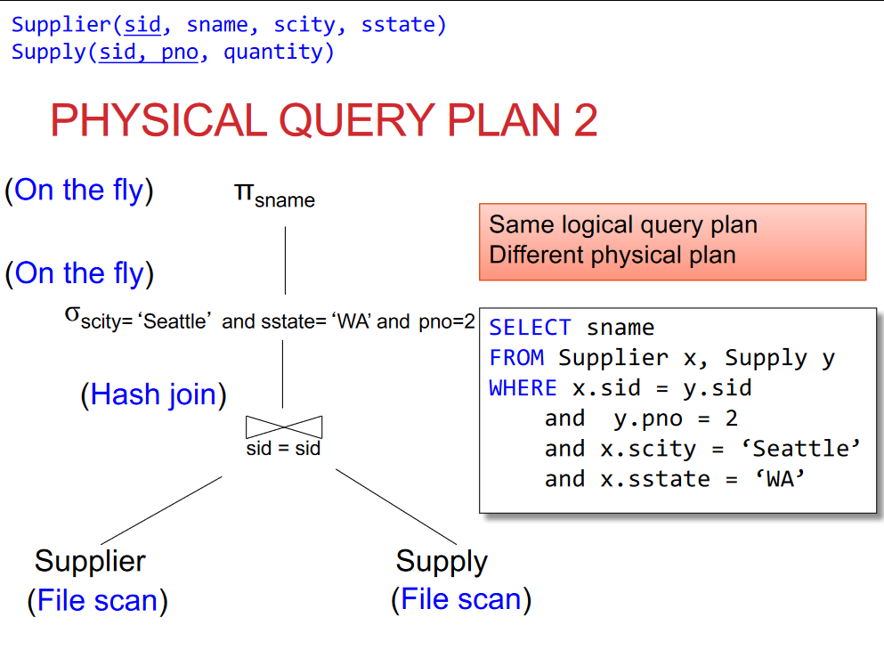

Slide 16
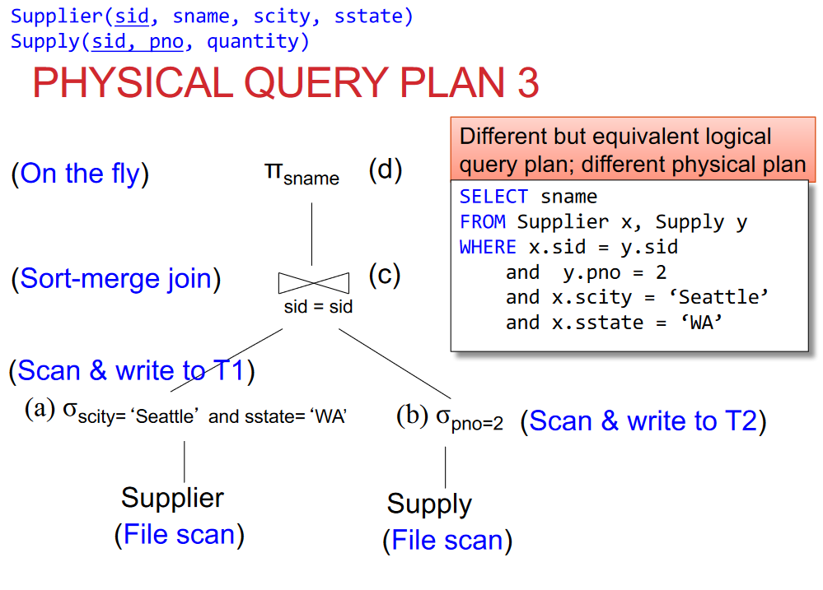

Slide 17
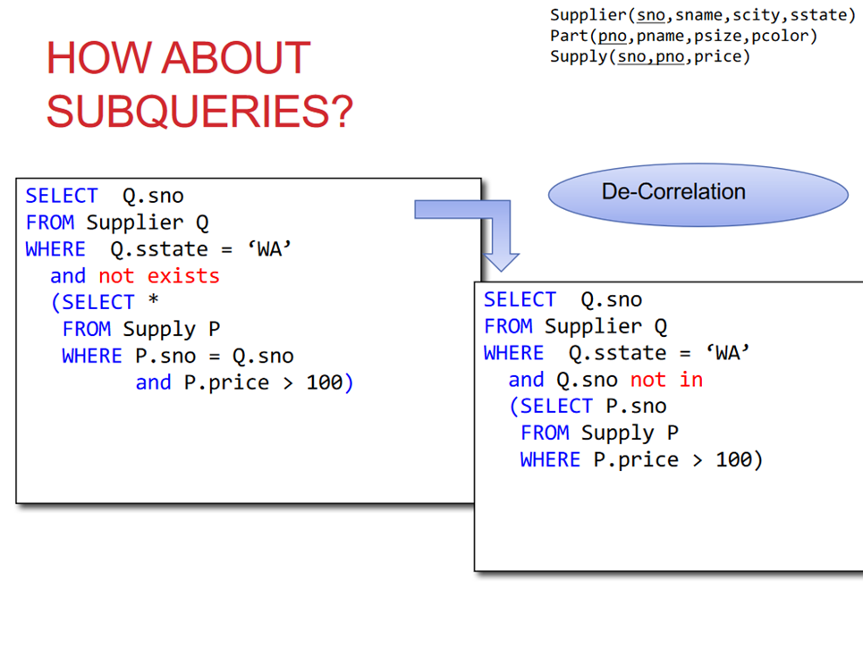

Slide 18
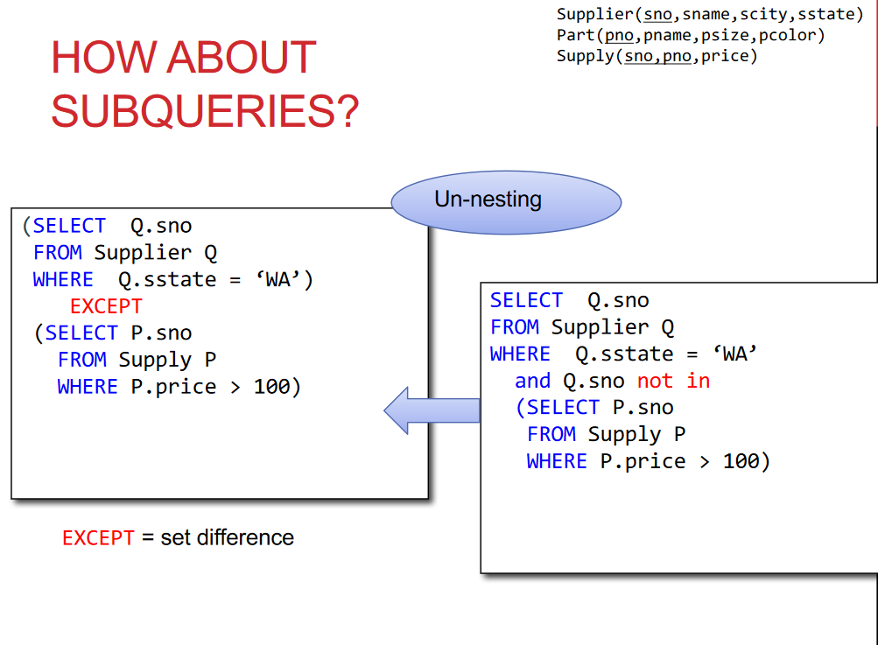

Slide 19
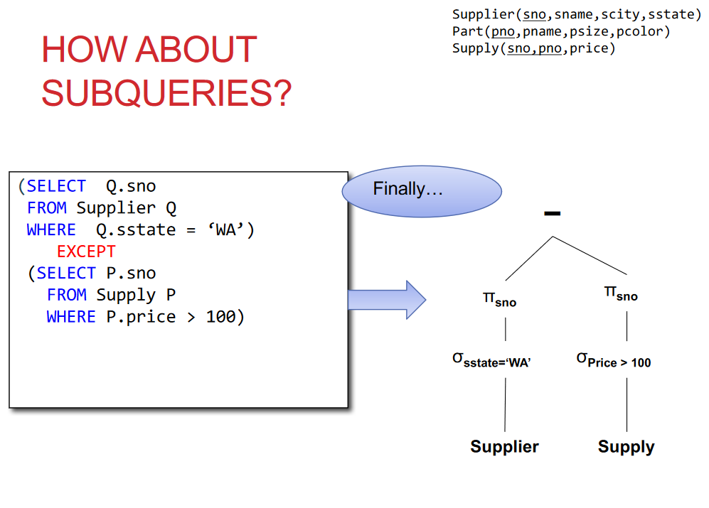

Slide 20
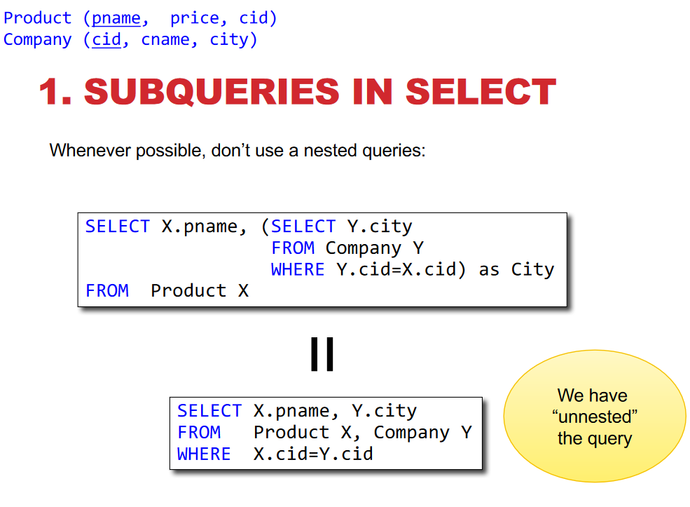

Slide 21
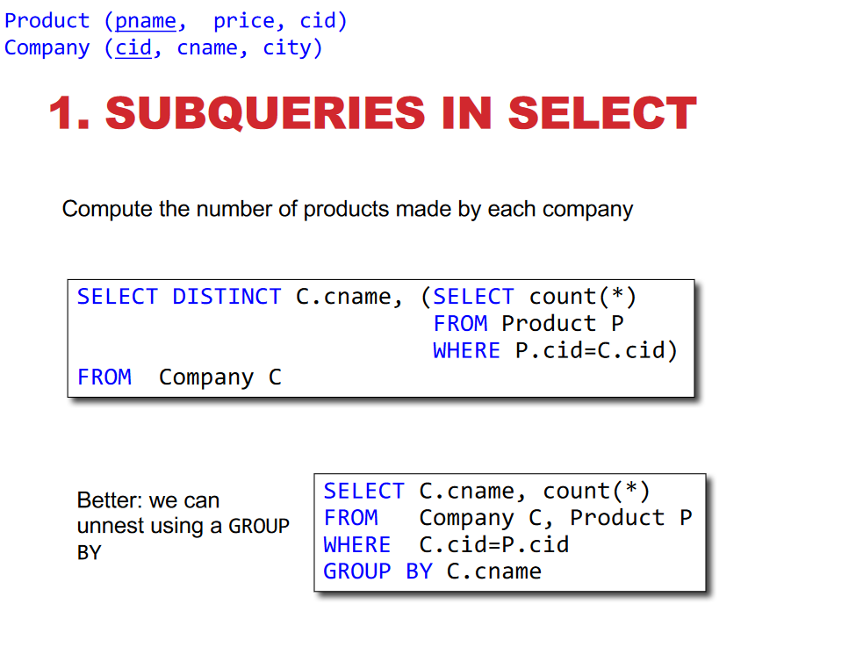

Slide 22
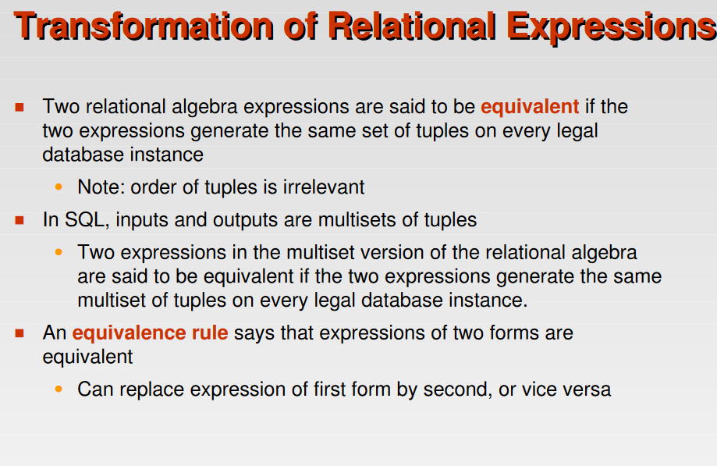

Slide 23
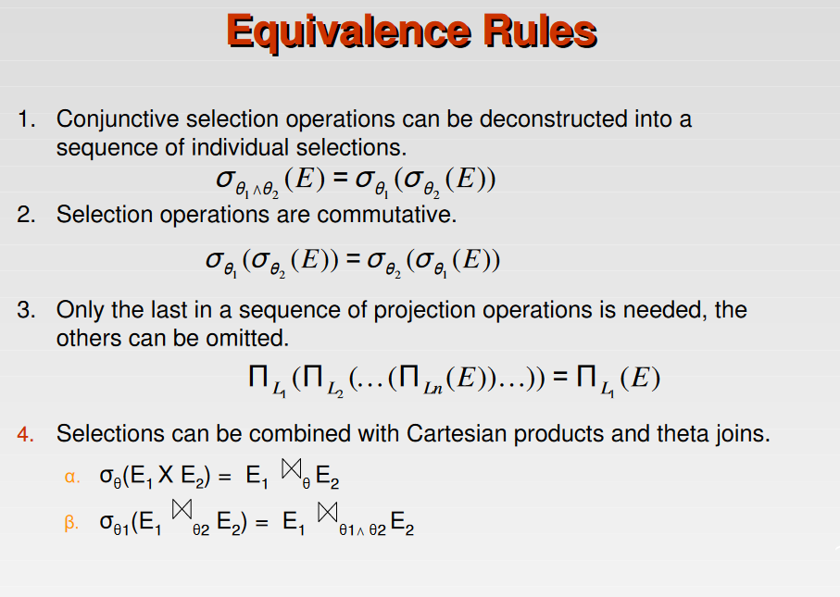

Slide 24
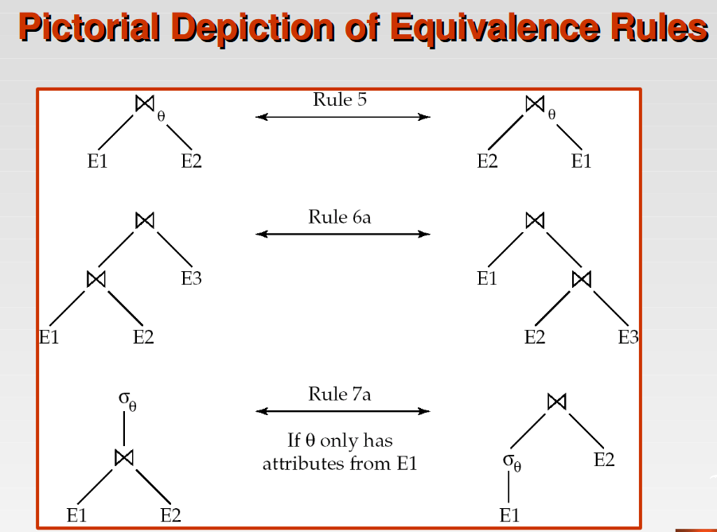

Slide 25
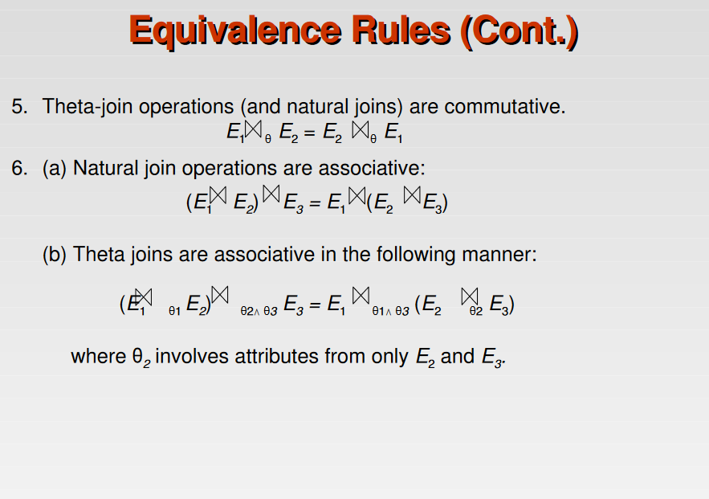

Slide 26
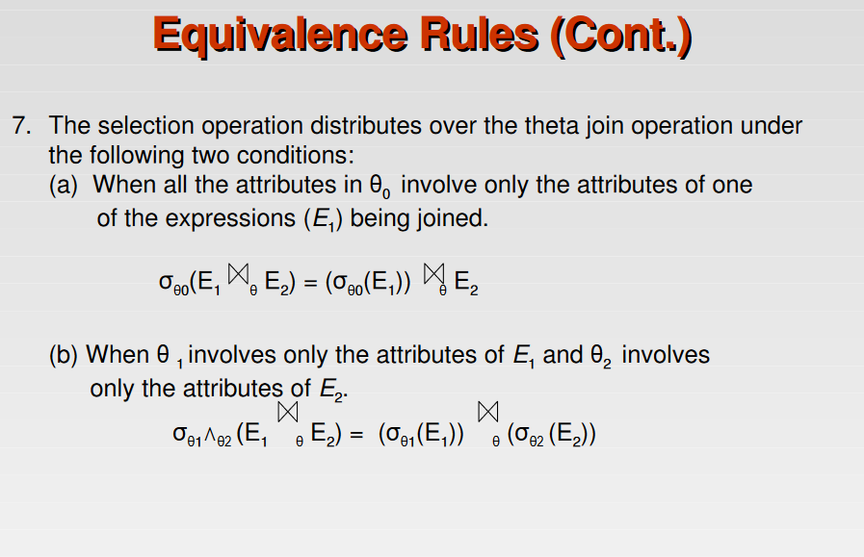

Slide 27
Examples of application of transformation rules
σ _{salary > 40000 and dno = 5}(employee) ≡ σ _{salary > 4000} (σ _{dno = 5}(employee))
σ _{salary > 40000} (σ_{dno = 5}(employee)) ≡ σ_{dno = 5} (σ _{salary > 40000} (employee))
π _{lname, fname, salary} (π _{lname, fname, salary, dno} (employee))
≡ π _{lname, fname, salary} (employee)
σ _{dno = dnumber} (employee × department)
≡ employee _{dno = dnumber} department

Slide 28
Heuristic optimization
Heuristics are thumb rules
Optimizer uses thumb rules to find out the execution
plan of a query.

Slide 29
Heuristic optimization algorithm
An outline the algorithm:
Break up any select operations with conjunctive conditions into a cascade of select operations.
Move each select operation as far down the query tree as is permitted by the attributes involved in the select condition.
Rearrange the leaf nodes of the tree so that the leaf node relations with the most restrictive select operations are executed first in the query tree representation.
Combine a Cartesian product operation with a subsequent select operation in the tree into a join operation.
Break down and move lists of projection attributes down the tree as far as possible by creating new project operations as needed.

Slide 30
Heuristic optimization
SELECT LNAME
FROM EMPLOYEE, WORKS_ON, PROJECT
WHERE PNAME = ‘AQUARIUS’ AND PNUMBER = PNO
AND ESSN = SSN AND BDATE > ‘1990-12-31’;

Slide 31
Relational algebra expression
π _{Lname}(σPname=‘Aquarius’ Λ Pnumber=Pno Λ Essn=Ssn Λ Bdate > ‘1990-12-31’(employee × works_on × project))

Slide 32
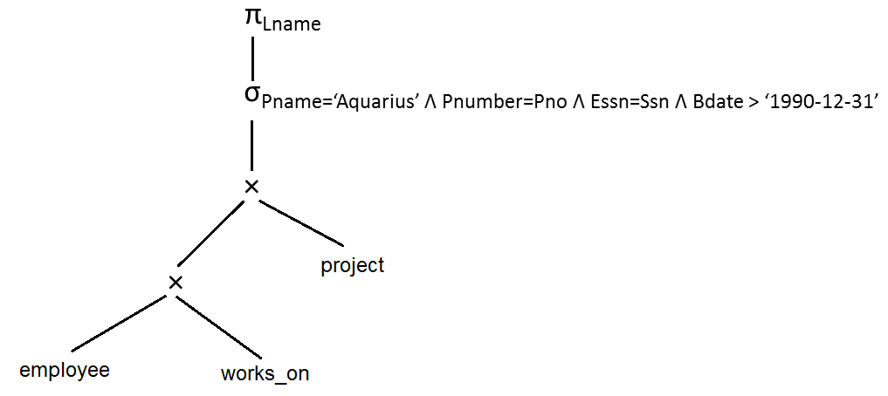
Query tree
Initial query tree

Slide 33
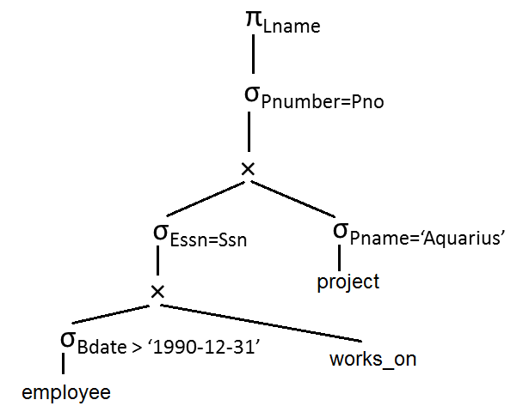
Heuristic optimization
Move the select operation down the tree as much as possible.

Slide 34
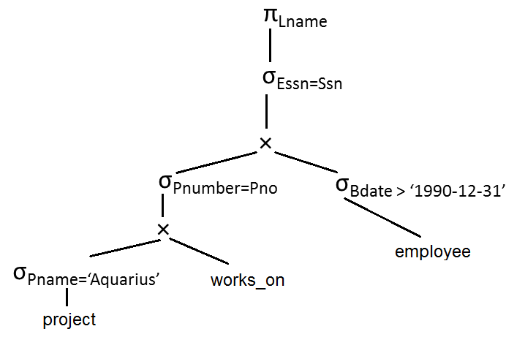
Heuristic optimization
Apply the most restrictive select operation first.

Slide 35
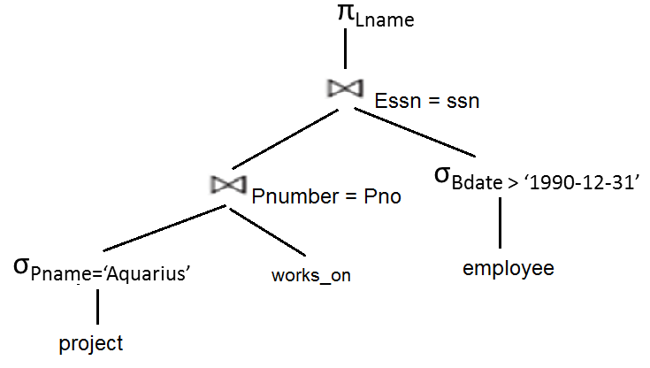
Heuristic optimization
Replace Cartesian product followed by join predicate by join operation.

Slide 36
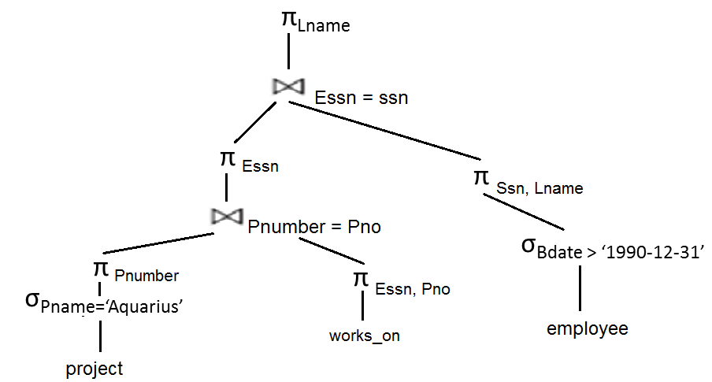
Heuristic optimization
Move project operation down the tree.

Slide 37
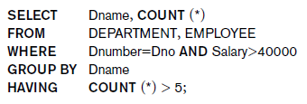
Exercise
Write down the expression for
relational algebra for the SQL statement
and convert it into the best evaluation
plan using heuristic optimization.

Slide 38
Relational algebra expression
π _{dname, count(*)} (Σ _{count(*) > 5} (_{dname} T_{count(*)}
(σ_{dnumber = dno Λ salary > 40000}(
employee × department))))

Slide 39
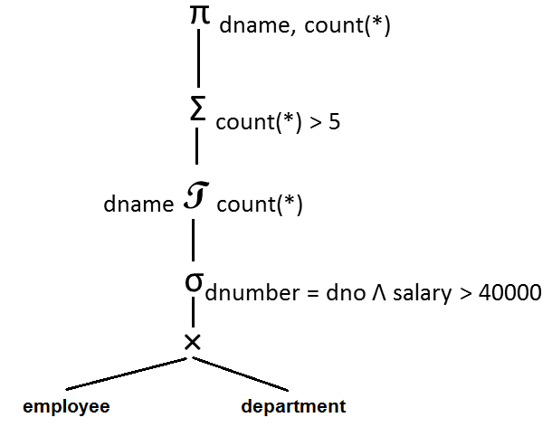
Heuristic optimization

Slide 40
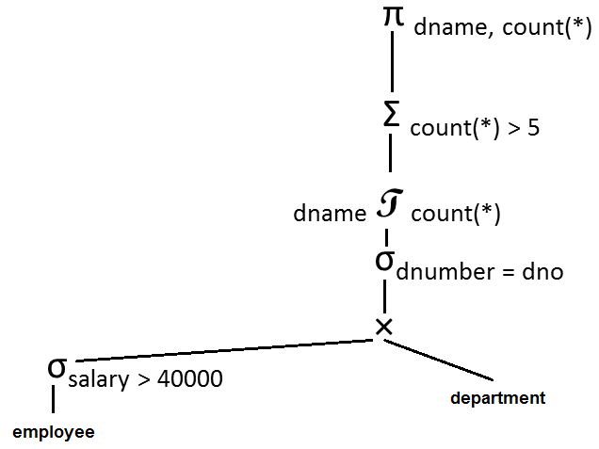
Heuristic optimization

Slide 41
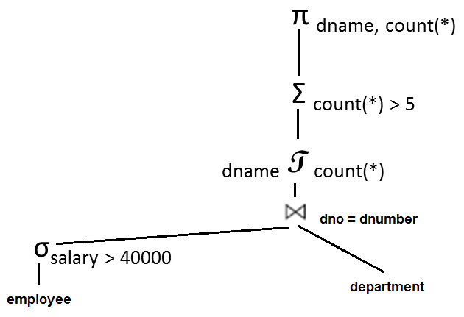
Heuristic optimization

Slide 42

Exercise
Write down the expression for
relational algebra for the SQL statement and convert it into the best evaluation plan using heuristic optimization.

